Slide 1
Team White Wolf
Client: Circle K International
George Mao, Jessica Zhao,
Kathy Wang, Aileen Cai, Shaina Verma

Slide 2
Our Client
We designed a website for Cornell Circle K, a philanthropic student organization.
They gave us some ideal features they were looking for: - Use of their logo and a consistent color scheme - A way to allow them to edit (add, update, and delete) events - A place to view photos and clear contact information

Slide 3
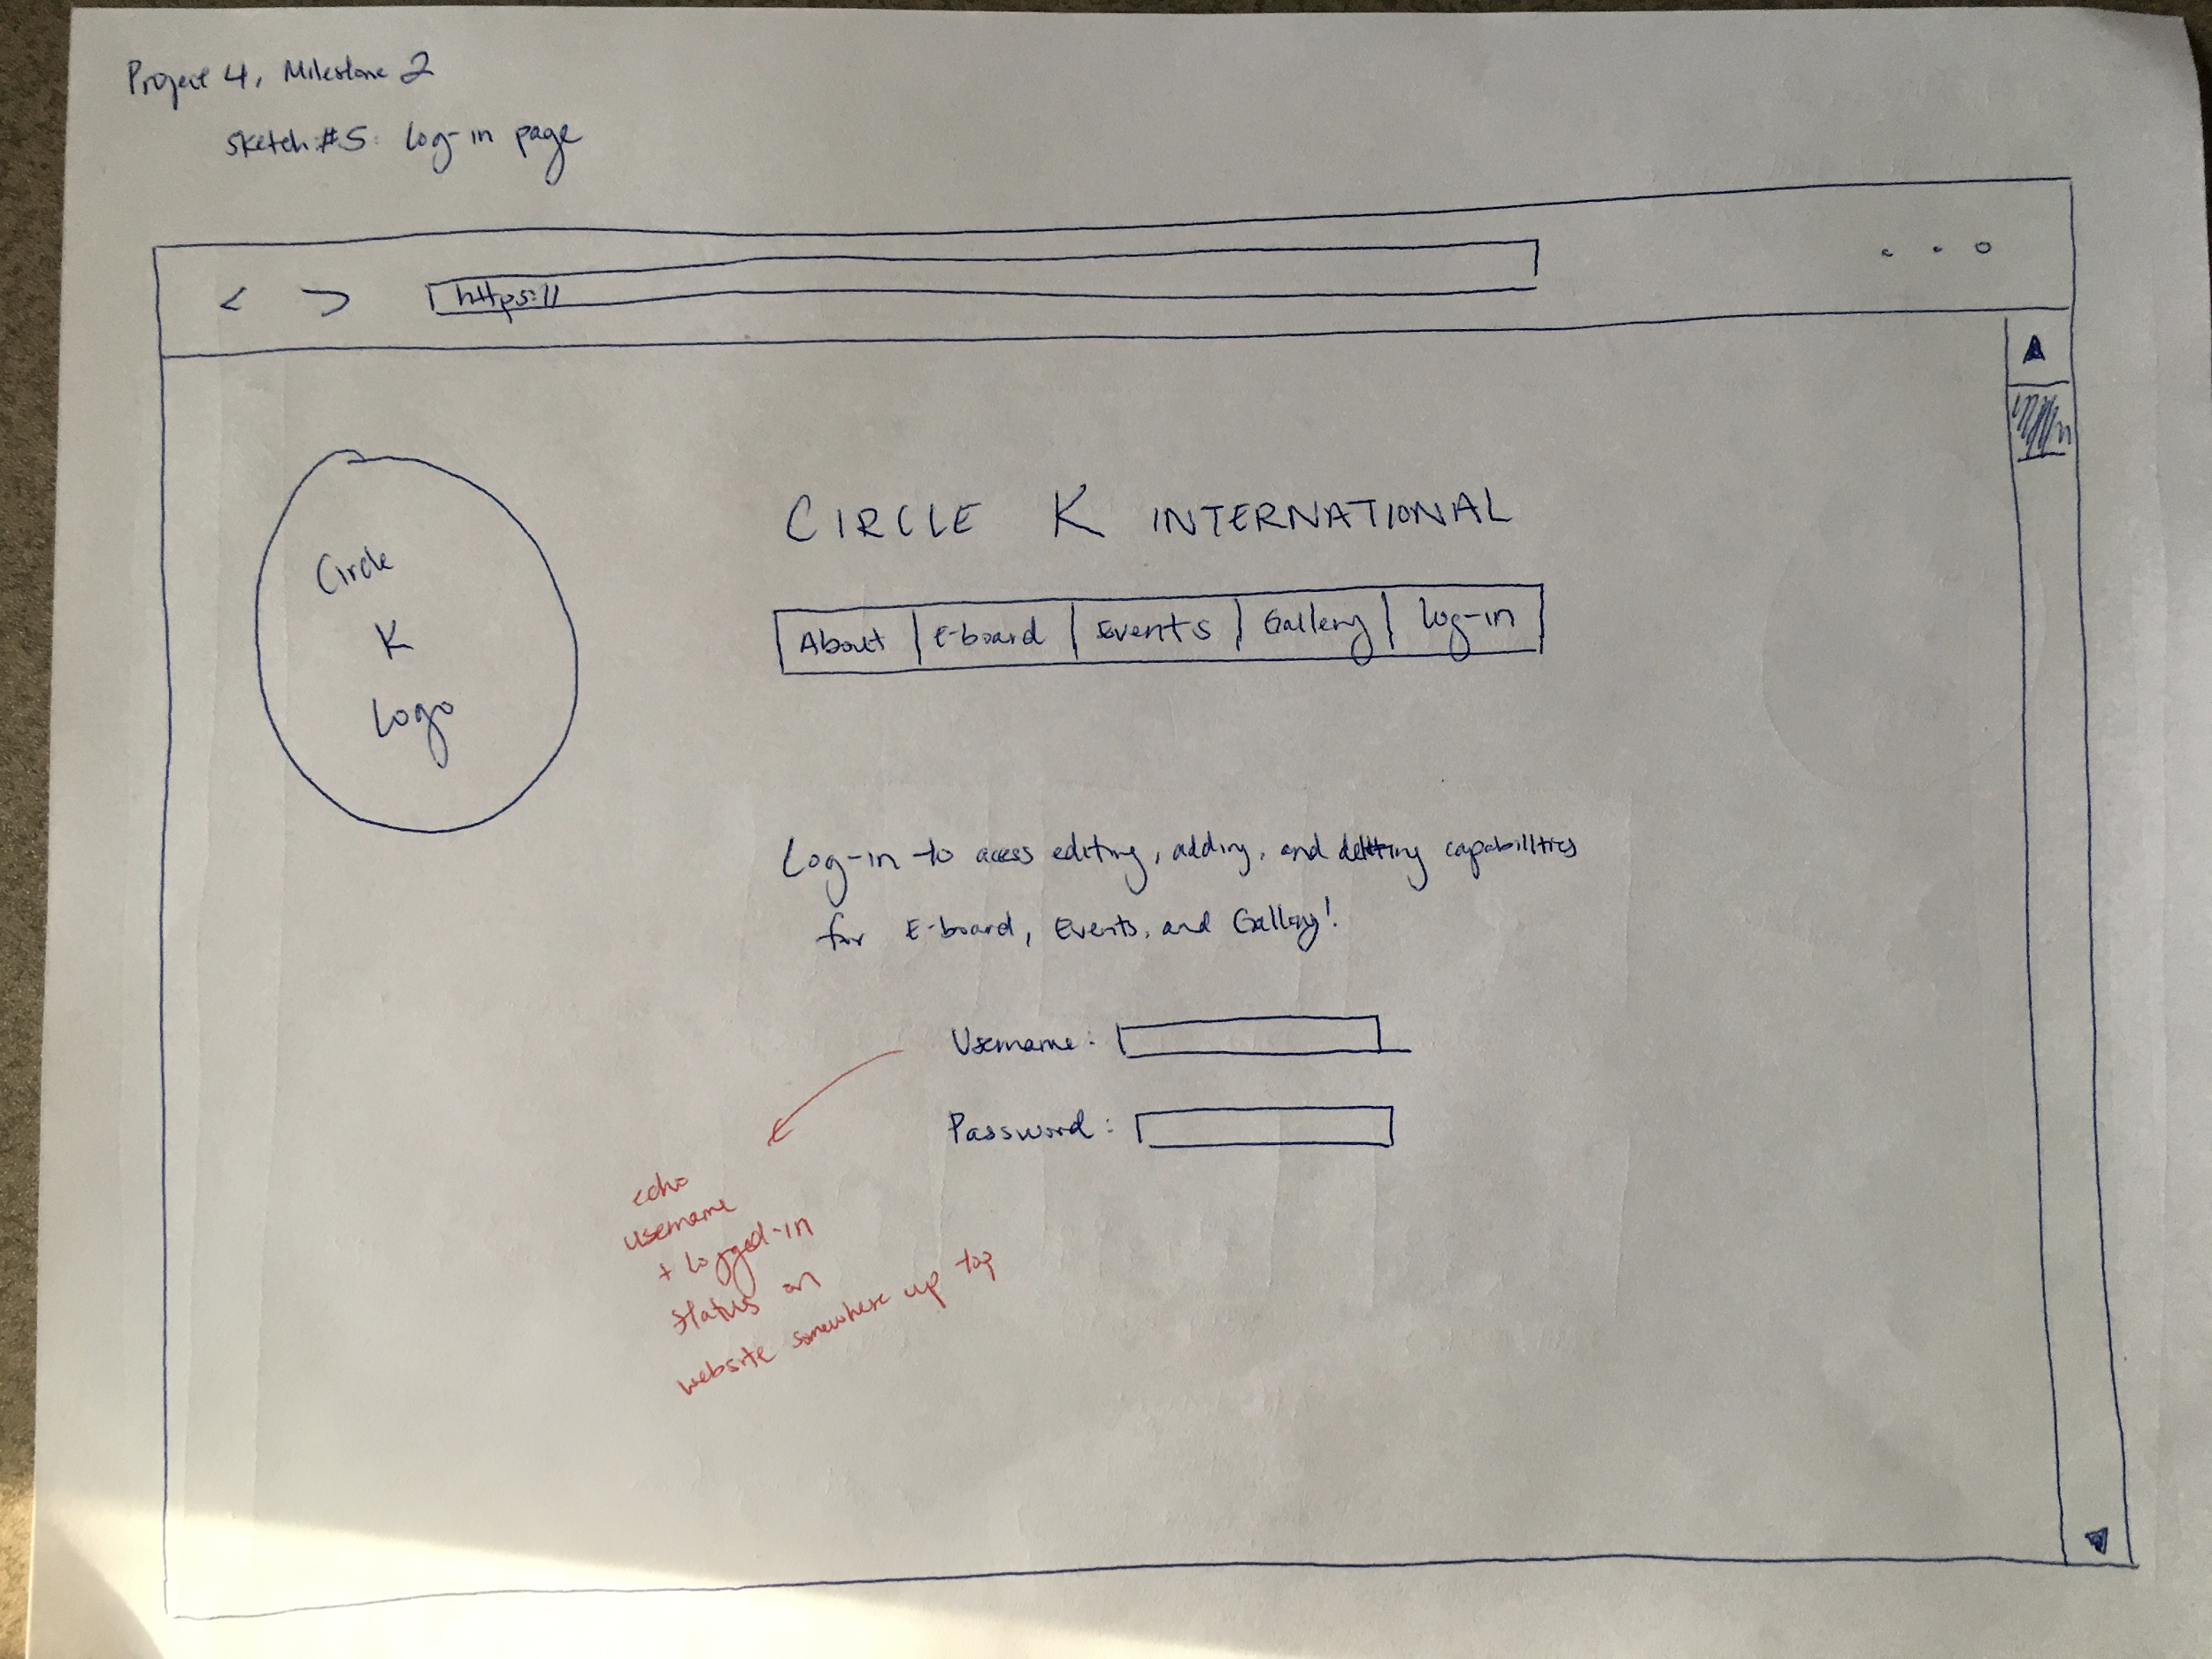
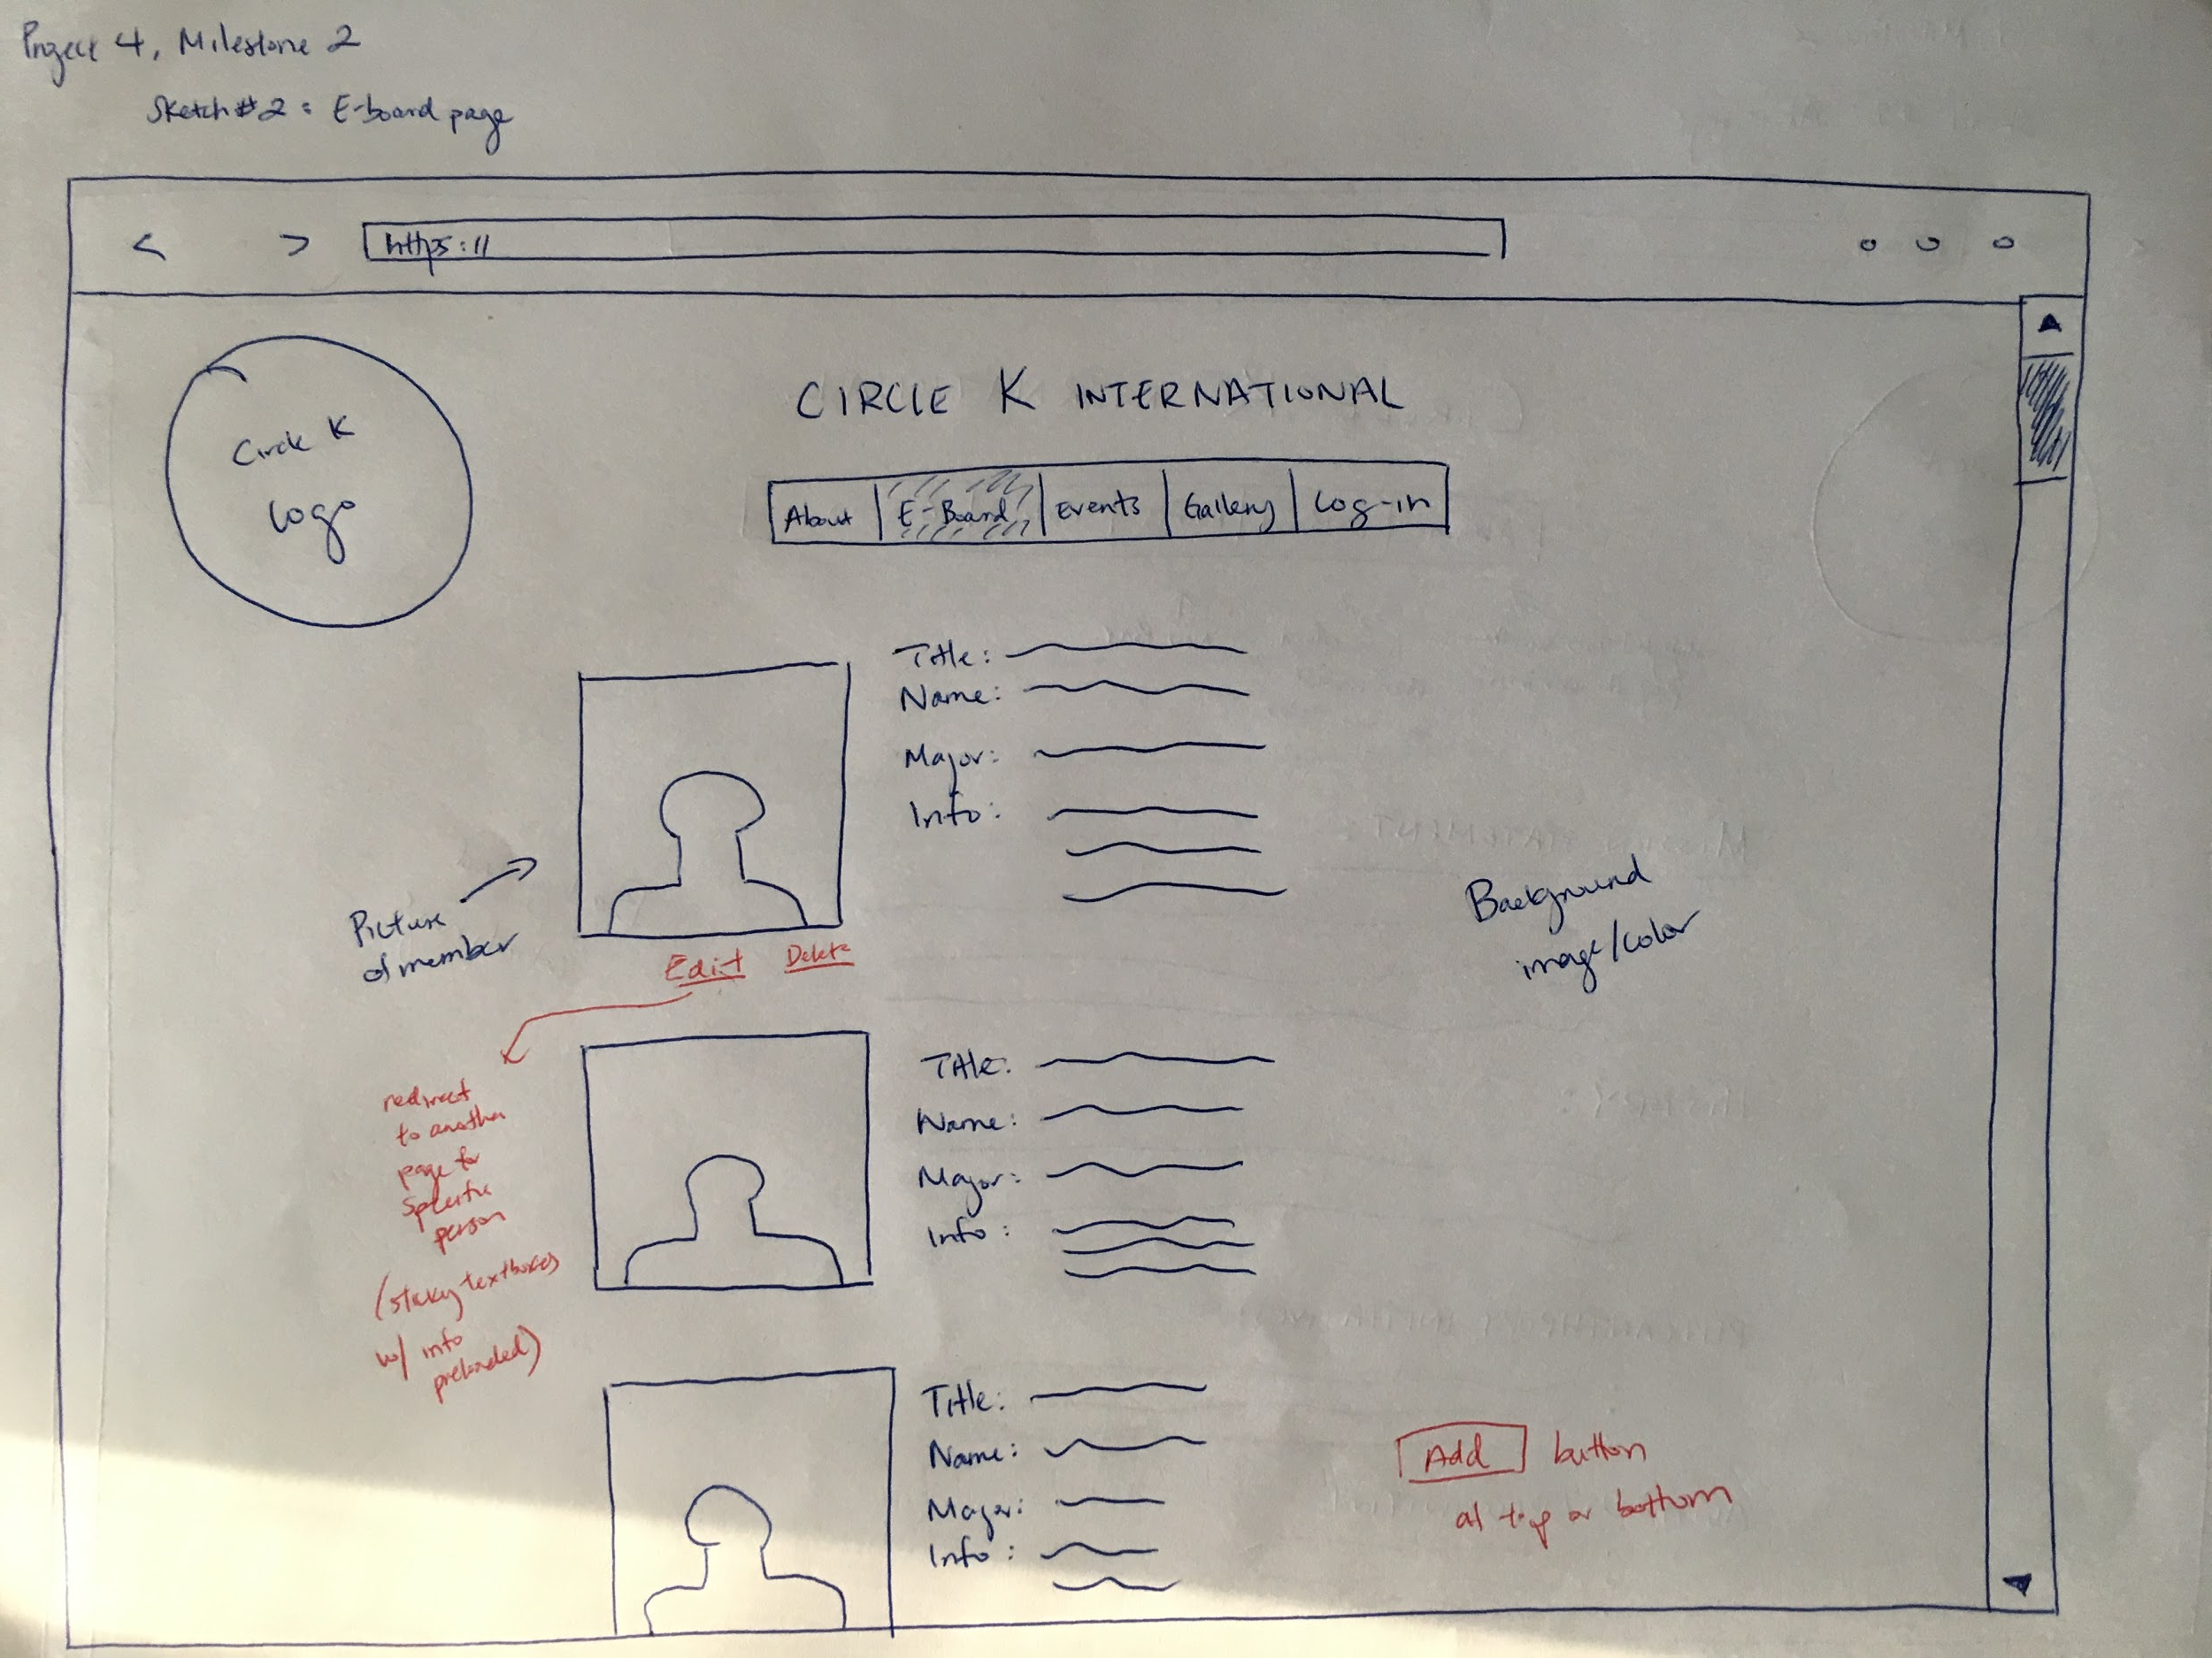
Sketches

Slide 4
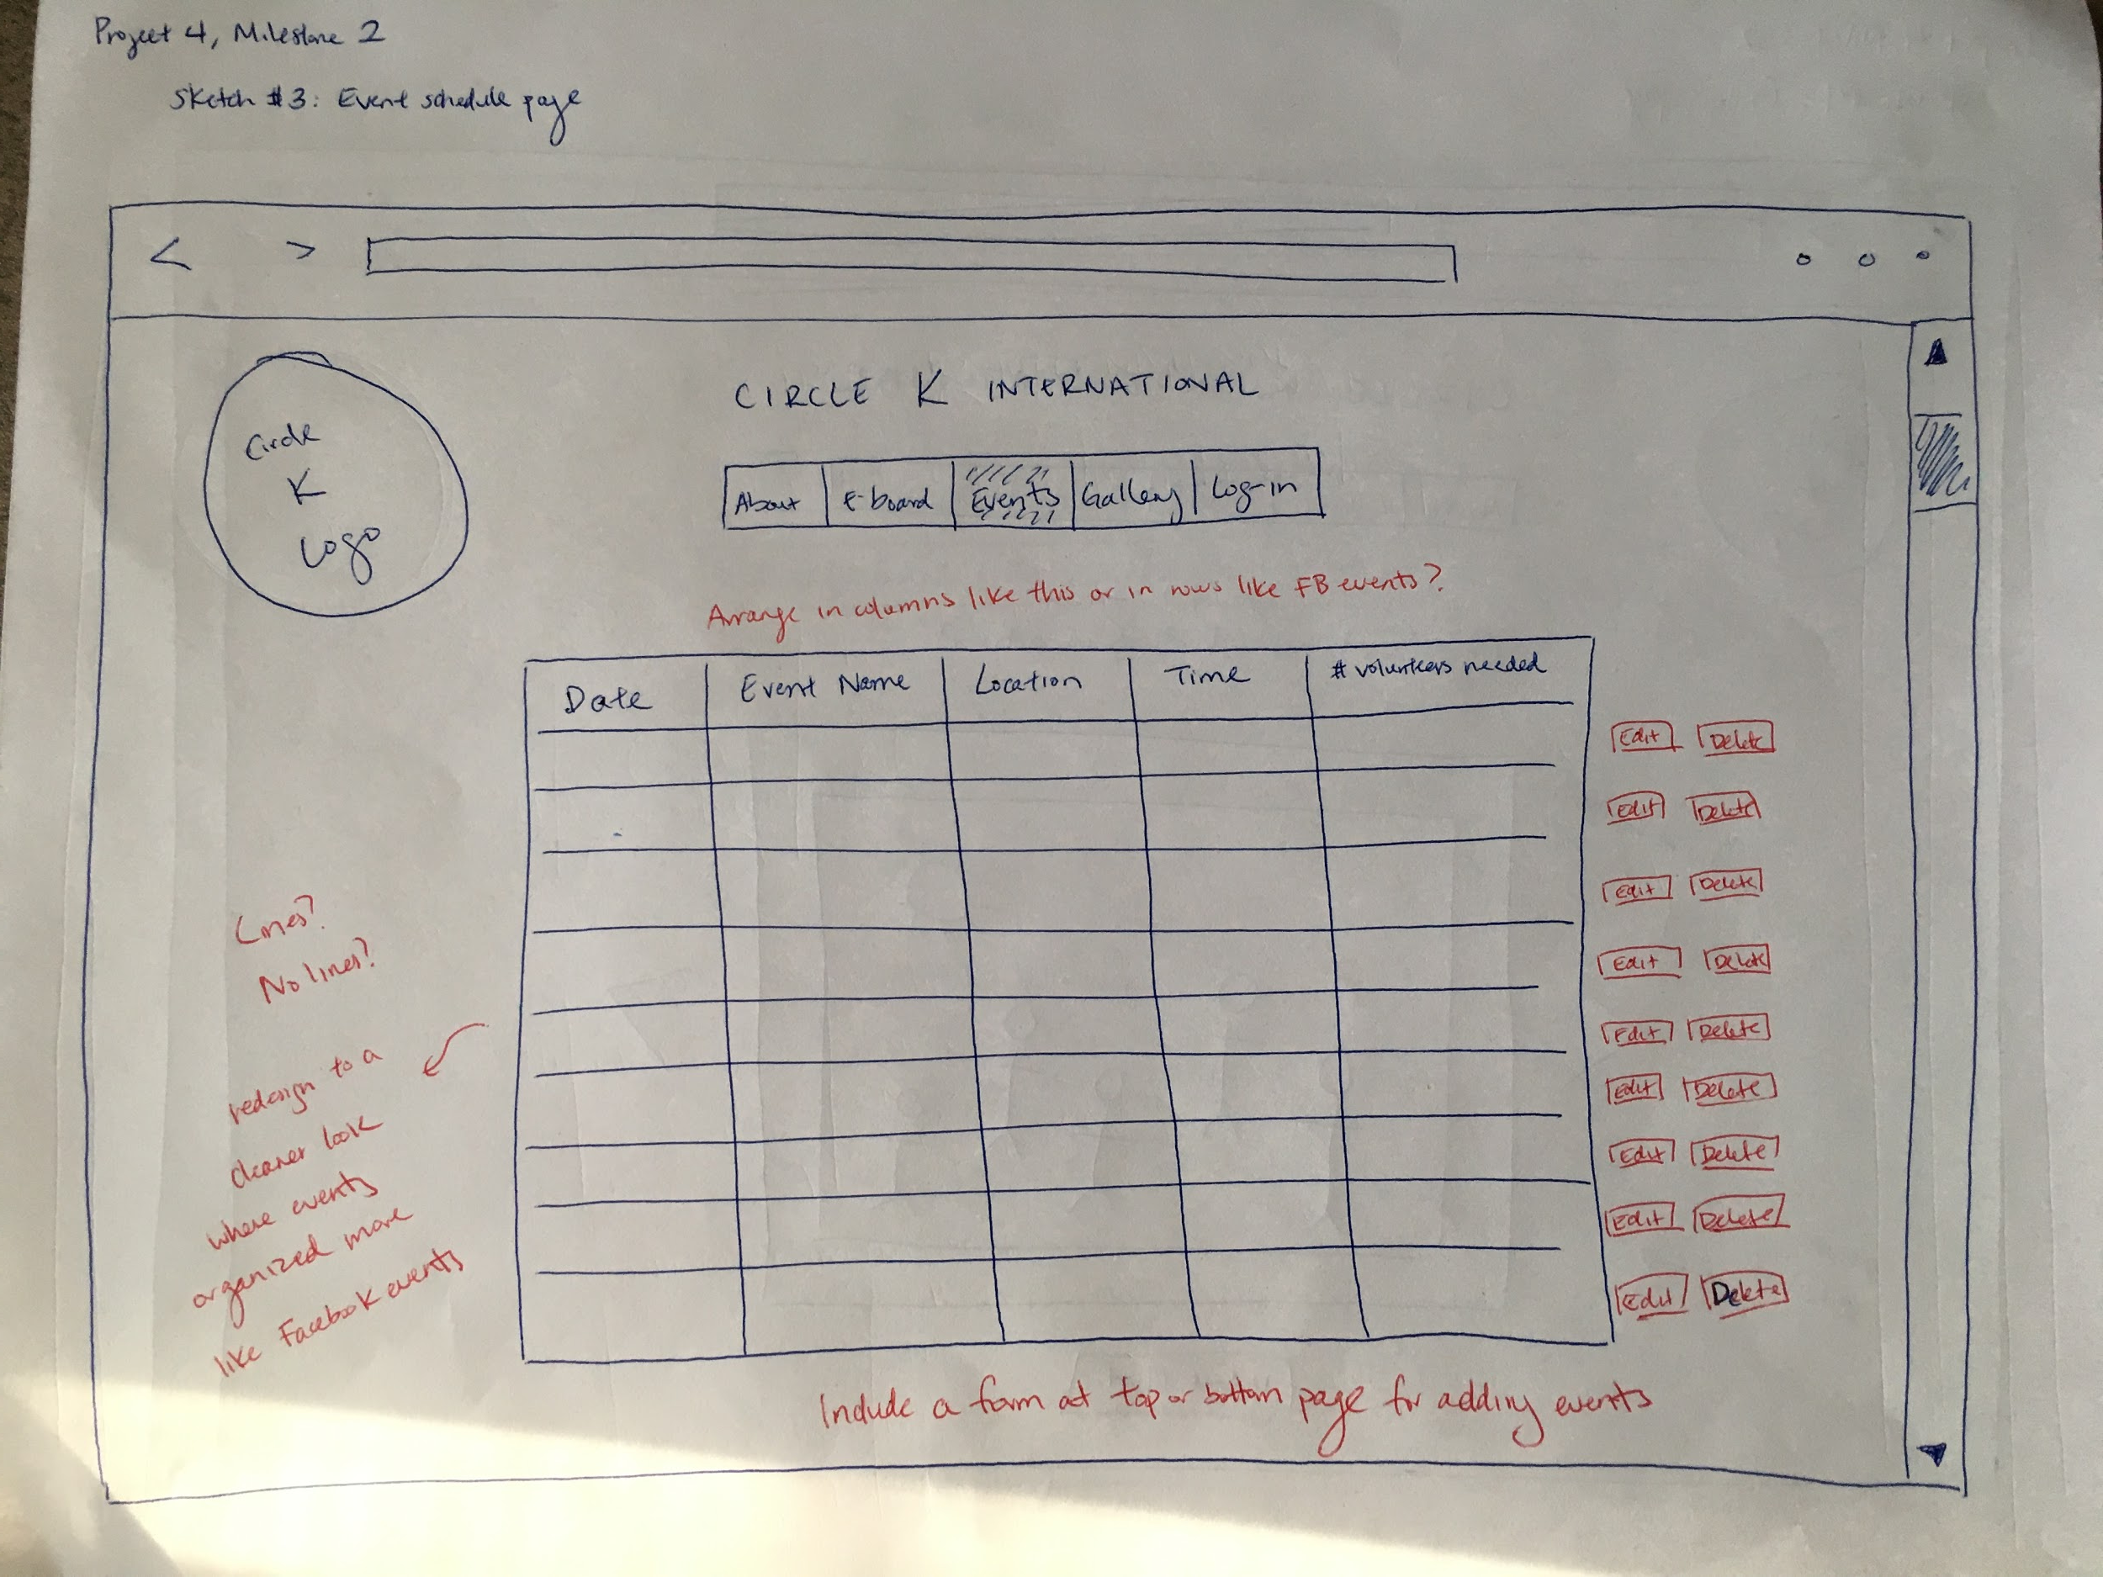
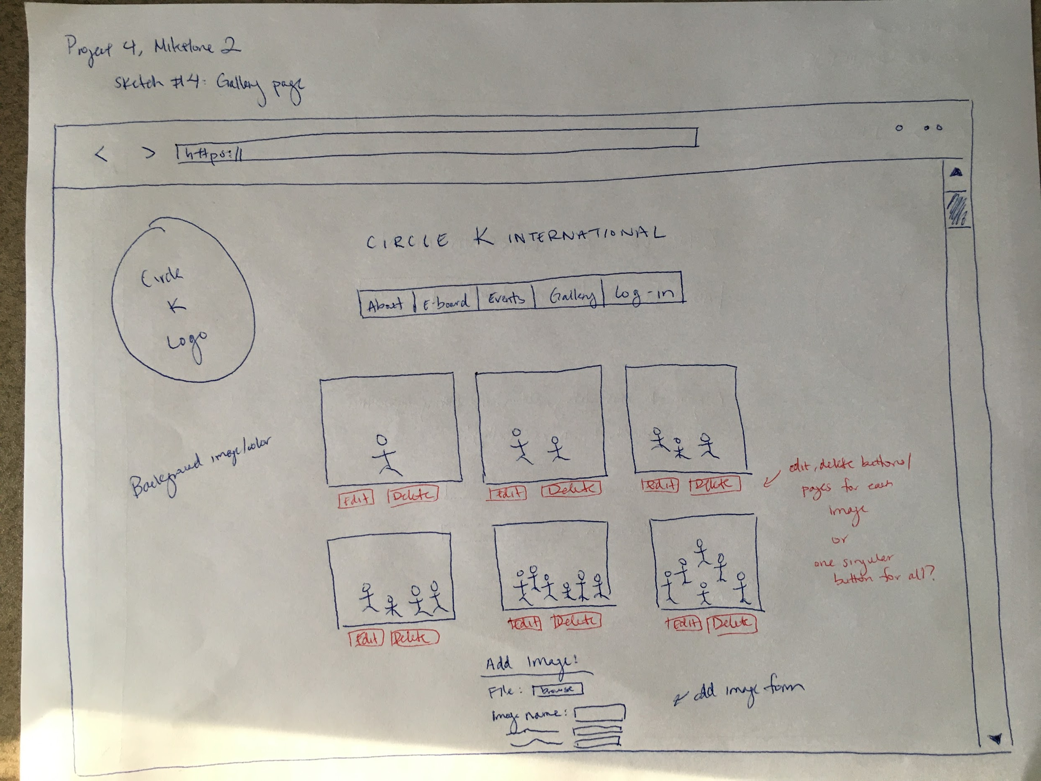
Sketches

Slide 5
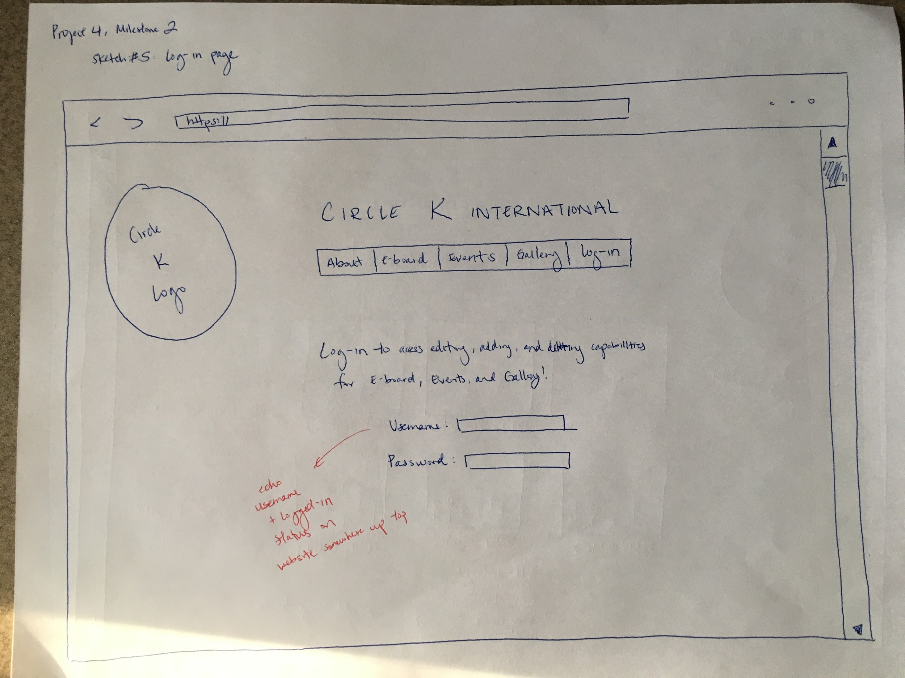
Sketches

Slide 6
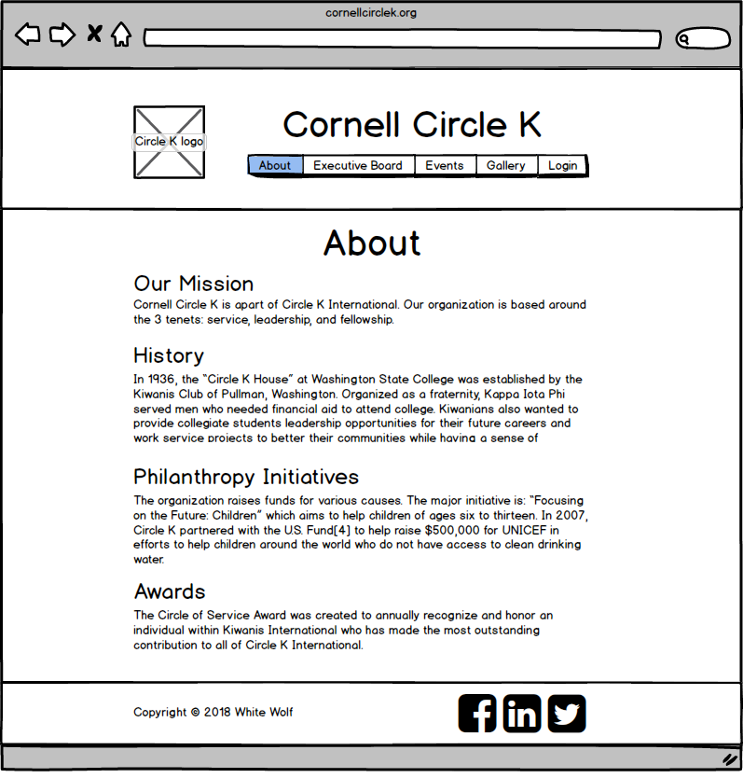
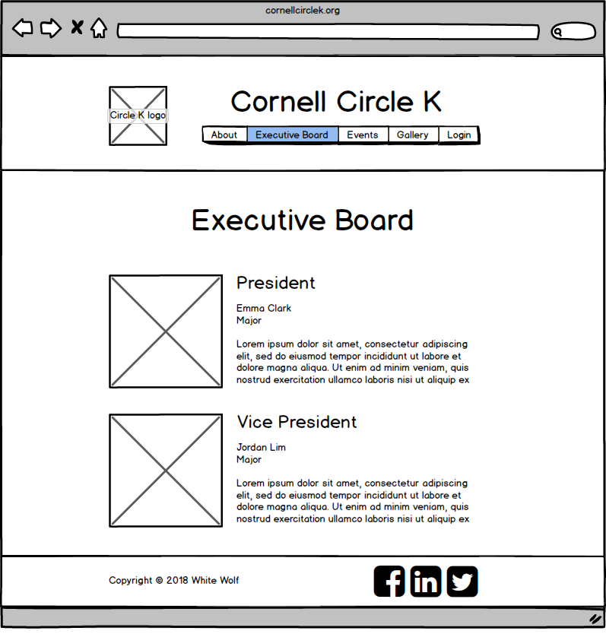
Wireframes

Slide 7
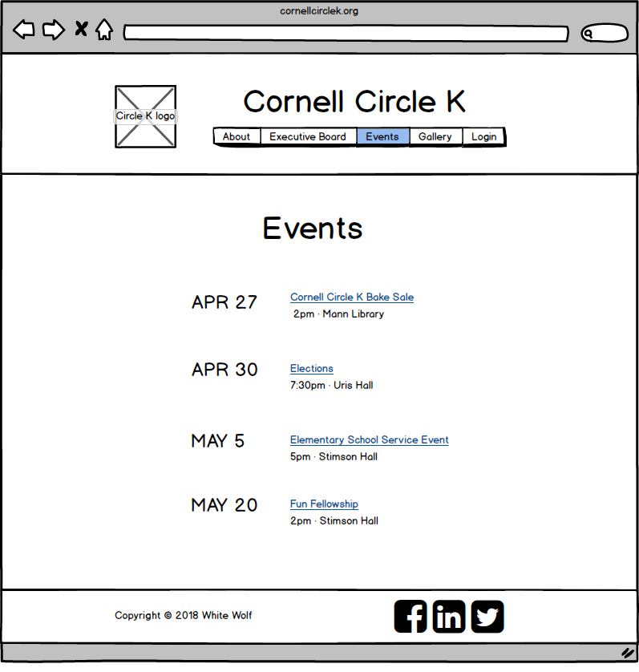
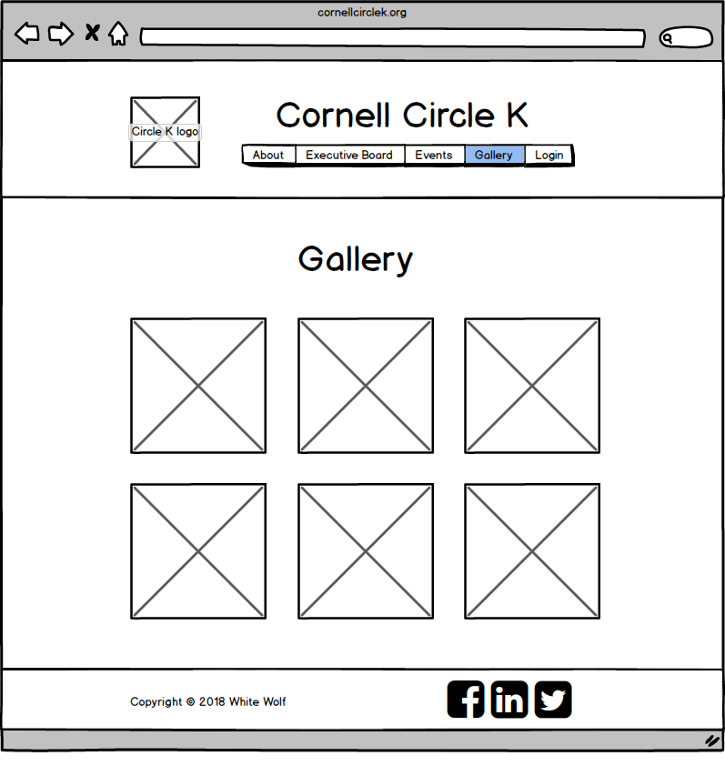
Wireframes

Slide 8
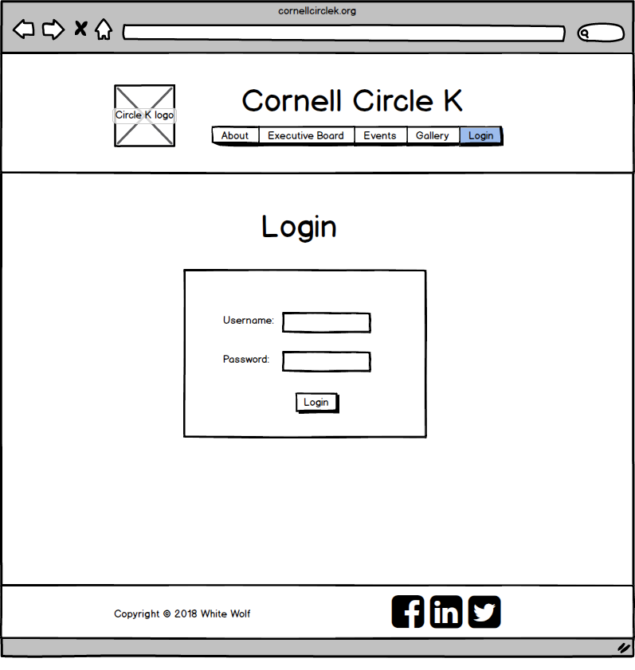
Wireframes

Slide 9
NOW FOR A LIVE DEMO!

